Slide 1
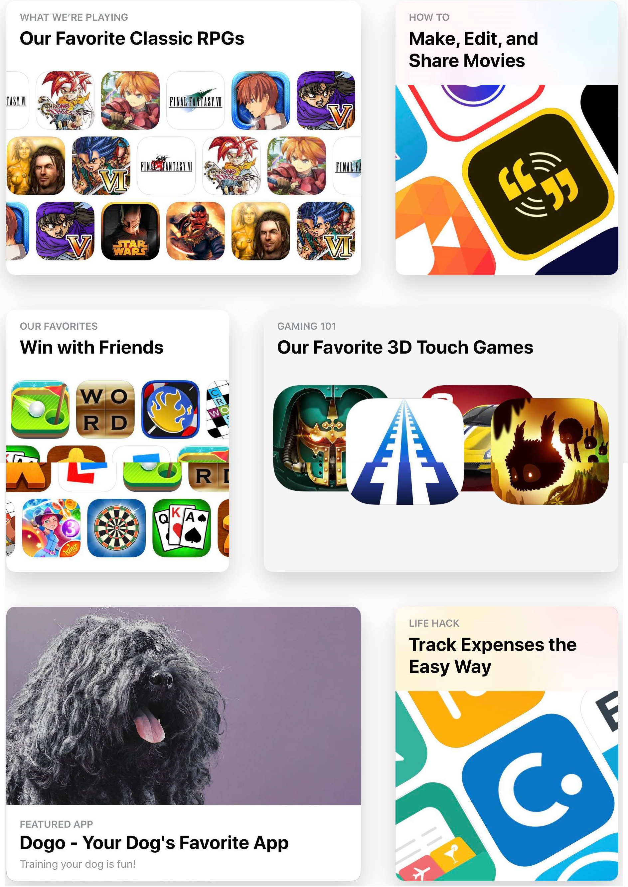
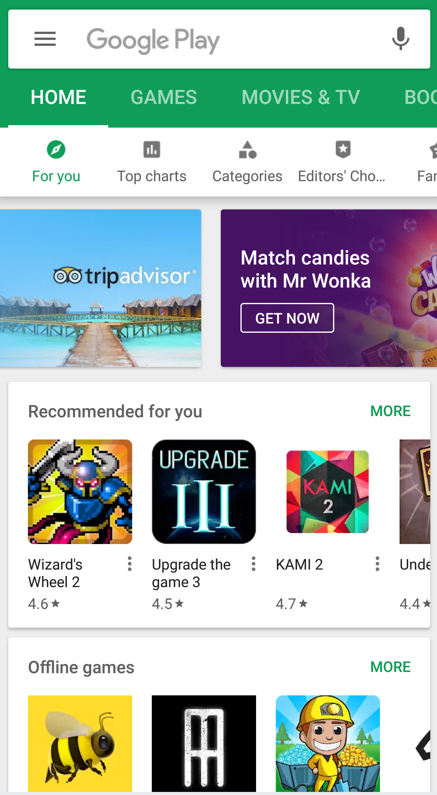
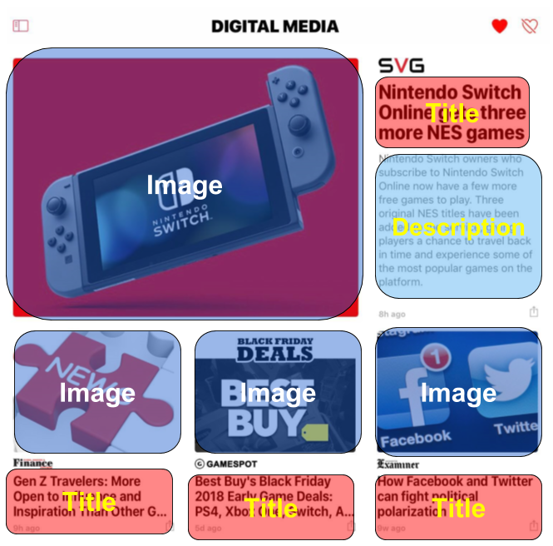
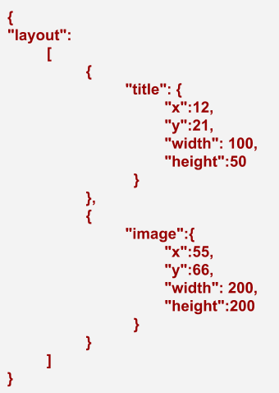
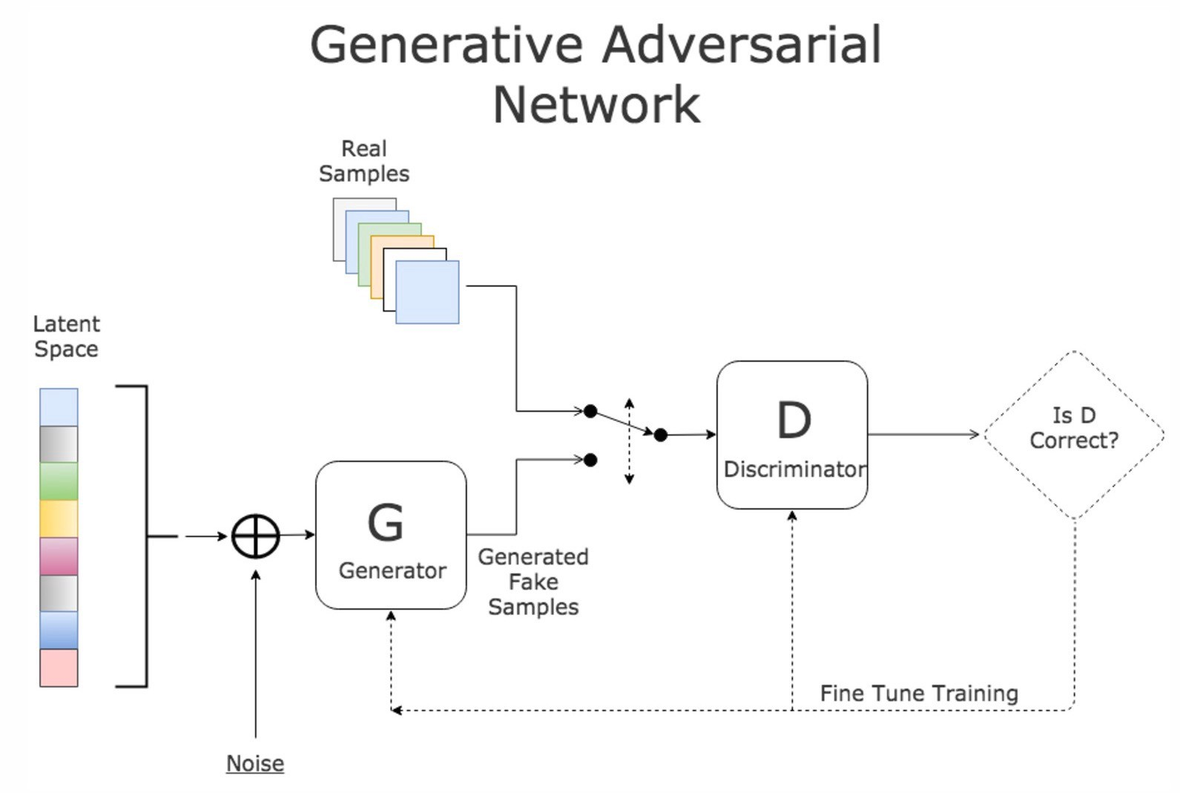
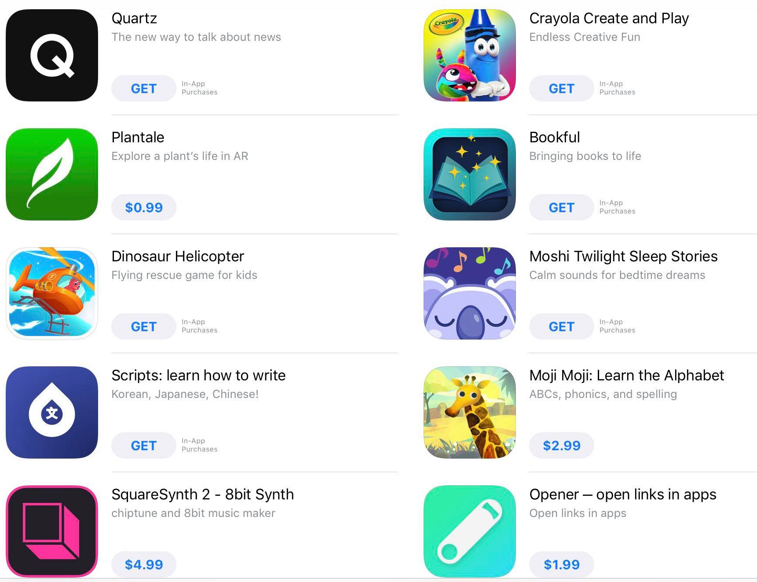
Auto Layout for Recommender
System using GAN
Dai Hoang Tran
dai-hoang.tran@hdr.mq.edu.au
Quan Z. Sheng
michael.sheng@mq.edu.au
Wei Emma Zhang
w.zhang@mq.edu.au
Department of Computing, Macquarie University, Sydney, Australia
1 - Goal
Provide better engagement content to users from auto generated layout that is not boring.
3 – Data Collection
The layout data is collected via real applications such as
Amazon website, Apple Appstore, etc.
2 – Idea: use gan to generate layout
4 – Data processing (Prototype)
A customized software is used to label different regions of the layout, then save to JSON format.
5 – GAN MODEL to generate auto layout compositions (WIP)
Use Generative adversarial Neural network model to learn the layout compositions, then it can generate item layout on the fly when user is browsing the content.
Auto layout
ABN 90 952 801 237 | CRICOS Provider 00002J

